Slide 1
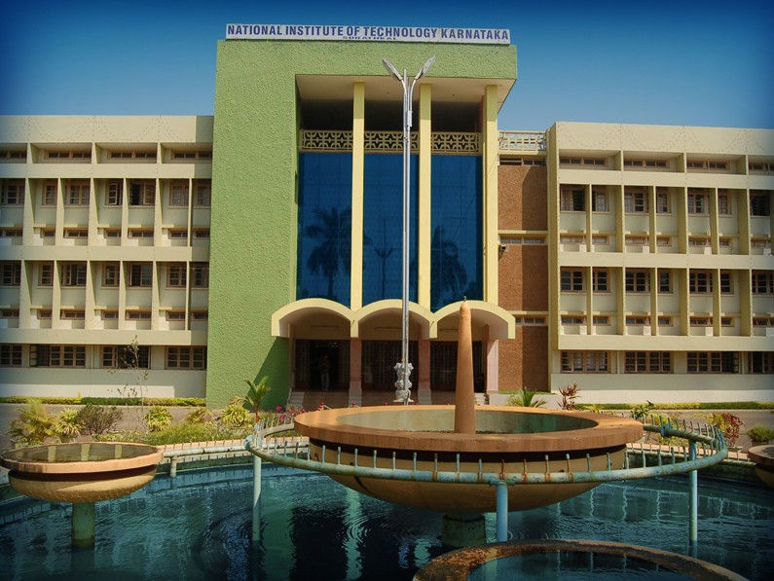
NATIONAL INSTITUTE OF TECHNOLOGY

Slide 2


PROJECT ON:-
SHELL IN “C”

Slide 3
SUBMISSION:-
SUBMITTED TO –
MS DEEPTHI L
SUBMITTED BY –
ADARSH THAKUR
BALU NAGAR
PARAS NARAYAN GAUTAM
ASHISH PATIDAR

Slide 4
WHAT IS SHELL ?
>A shell is a program that takes commands typed by the user and calls the operating system to run those commands.
>A shell is a program that acts as the interface between you and the system, allowing you to enter the command for the operating system for execute.
>Shell accepts your instructions or commands in English and translate it into Computers native binary language. server.

Slide 5
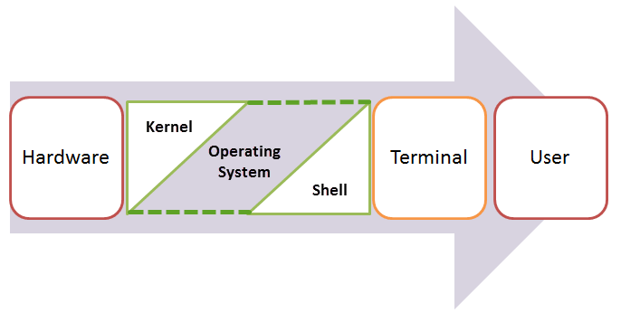

Slide 6
Headers files used In our program:-
#include <sys/wait.h>
#include <sys/types.h>
#include <unistd.h>
#include <stdlib.h>
#include <stdio.h>
#include <string.h>

Slide 7
Functions used in our header files
1:- #include <sys/wait.h>
waitpid()
The waitpid() system call suspends execution of the calling process until a child specified by pid argument has changed state. By default, waitpid() waits only for terminated children.
Pid is ‘process ID number’.
System call:- In computing, a system call is the programmatic way in which a computer program requests a service from the kernel of the operating system it is executed.

Slide 8
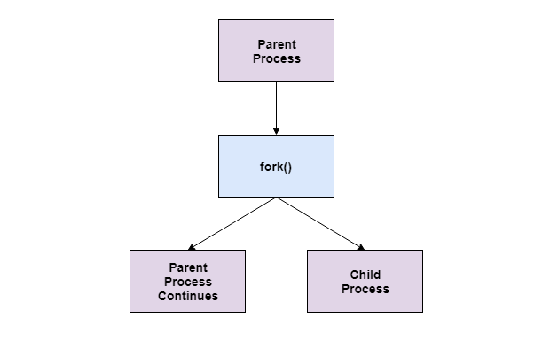
A diagram that demonstrates parent and child process

Slide 9
Parent process:-
All the processes in operating system are created when a process executes the fork() system call except the startup process. The process that used the fork() system call is the parent process. In other words, a parent process is one that creates a child process. A parent process may have multiple child processes but a child process only one parent process.
On the success of a fork() system call, the PID of the child process is returned to the parent process and 0 is returned to the child process. On the failure of a fork() system call, -1 is returned to the parent process and a child process is not created

Slide 10
Child process:-
A child process is a process created by a parent process in operating system using a fork() system call. A child process may also be called a subprocess or a subtask.
A child process is created as its parent process’s copy and inherits most of its attributes. If a child process has no parent process, it was created directly by the kernel.

Slide 11
2 #include <unistd.h>
1:- chdir()
The chdir command is a system function (system call) which is used to change the current working directory.
2:- fork()
Fork system call is used for creating a new process, which is called child process, which runs concurrently with the process that makes the fork() call (parent process). After a new child process is created, both processes will execute the next instruction following the fork() system call.

Slide 12
3 #include <stdlib.h>
1:- malloc()
malloc” or “memory allocation” method in C is used to dynamically allocate a single large block of memory with the specified size. It returns a pointer of type void which can be cast into a pointer of any form.
2:- realloc()
“realloc” or “re-allocation” method in C is used to dynamically change the memory allocation of a previously allocated memory.
3:- free()
It simply free the memory allocated by the variable.
4:- execvp()
The execvp() function replaces the current process with a new process specified by file.

Slide 13
4:- #include<stdio.h>
1:- fprintf()
The fprintf() function is used to write set of characters into file.
2:-getchar()
getchar is a function in C programming language that reads a single character from the standard input stream stdin, regardless of what it is, and returns it to the program.

Slide 14
5 #include<string.h>
1:- strcmp()
strcmp() compares the two strings means it starts comparison character by character starting from the first character until the characters in both strings are equal or a NULL character is encountered
2:- strtok()
breaks string str into a series of tokens using the delimiter delim.
Delimiter:- Suppose, we've the following string and we want to extract the individual words
Char str[] = “shell in c”;
Here words are separated by space. So space will be our delimeter.
Char delim[] = “ ”;

Slide 15
Basic terminology of a shell:-
Read: Read the command from standard input.
Parse: Separate the command string into a program and arguments.
Execute: Run the parsed(splitted) command

Slide 16
The 3 functions of shell:-
1:- read_line();
2:- split_line();
3:- execute();

Slide 17
#:- read_line();
It simply reads the line which is given by the user
#:- split_line();
It split the input line in two segments
I command
ii arguments of commands
For example
gedit shell.c
So here “gedit” is command and “shell.c” is argument

Slide 18
#:- execute()-
It will execute the parse commands

Slide 19
Features of Our project
Own design commands
Networking

Slide 20
Own making commands (which all are inbuilt inside our shell code)
1:- change directory
For this we have use “change_dir()” function.
2:- exit from the shell
For this we have use “shell_exit()” function.

Slide 21
3:- copy Files Data(cpy)
For this we have use “write()” and “read()” function.
4:- current directory files(cdf)
For this we have use “opendir()” and “readdir()” function.
5:- remove directory(rmod)
For this we have use “execvp()” function.
6:- create files(cref)
For this we have use “open()” and “close()” function.

Slide 22
7:- current directory path(cds)
For this we have use “getcwd()” and “chdir()” function.
8:- back directory(back)
For this we have use “chdir()” and “getcwd()” function.
9:- current folder(crefo)
For this we have use “mkdir()” function.

Slide 23
Networking in “C” :-
through socket programming

Slide 24
Socket programming :-
A socket is one endpoint of a two-way communication link between two programs running on the network. A socket is bound to a port number so that the TCP layer can identify the application that data is destined to be sent to. The programming with these sockets is called socket programming.
An endpoint is a combination of an IP address and a port number. Every TCP connection can be uniquely identified by its two endpoints. That way you can have multiple connections between your host and the server.

Slide 25
Concept and analogy :-
A TELEPHONE CALL ON A TELEPHONE NETWORK WORKS AS FOLLOWS:-
Both the parties have telephone installed.
A phone number (or IP address)is assigned to each telephone.
Turn on ringer to listen for a caller.
Caller lifts telephone and dials a number.
Telephone rings and receiver of the call picks it up.
Both parties talk and exchange data.
After conversion is over they hang up the telephone.

Slide 26
Socket description :-
Socket() - Endpoint for communication.
Bind() - Assign a unique telephone number.
Listen() - Wait for a caller.
Connect() - Dial a number.
Accept() - Receive a call.
Send(), Recv() - Talk.
Close() - Hang

Slide 27
Overview
Client
Server
socket
socket
Server get
ready to
listen
Client get
Ready to
connect
bind
listen
Connection
request
connect
accept
Client/server information exchange
write
read
read
write
close
EOF
read
close

Slide 28
Server details:-
FUNCTIONS & OPERATIONS PERFORMED IN SERVER CODE:-
Socket()
Assigning IP / PORT
Bind()
Listen()
Accept()
Read()
Write()
Close()

Slide 29
SOCKET()
A socket is one endpoint of a two-way communication link between two programs running on the network. A socket is bound to a port number so that the TCP layer can identify the application that data is destined to be sent to.

Slide 30
Assign IP/PORT
Define the IP Address:-
A computer data network assigns a number called an Internet Protocol (IP) address to every computer and device connected to it. For example, your company’s Wi-Fi network might host many devices – smartphones, wireless printers and laptops. Each has an IP address.
Define the Port Address:-
Every computer and mobile device runs many different internet-based apps, including email, web browsers and cloud storage drives. Each of these applications has one or more network “ports” assigned to it; for example, web browsers use port 80(HTTP) ,email programs use port 25(SMTP) and file transfer use port 21(FTP).

Slide 31
Bind()
Bind() defines a relationship between the socket you created and the addresses that are available on your host (SERVER). For example you can bind a socket on all addresses or on a specific IP which has been configured on a network adapter by the host's operating system.

Slide 32
LISTEN()
The listen system call allows the process to listen on the socket for connections. The first argument is the socket file descriptor, and the second is the size of the backlog queue, i.e., the number of connections that can be waiting while the process is handling a particular connection.

Slide 33
Connect() in client:-
The connect function is called by the client to establish a connection to the server. It takes three arguments, the socket file descriptor, the address of the host to which it wants to connect (including the port number), and the size of this address. This function returns 0 on success and -1 if it fails.

Slide 34
Accept()
The accept() call is used by a server to accept a connection request from a client. When a connection is available, the socket created is ready for use to read data from the process that requested the connection. The call accepts the first connection on its queue of pending connections for the given socket socket.

Slide 35
Close() :-
When you have finished using a socket, you can simply close its file descriptor with file close.

Slide 36
TCP vs UDP
UDP: User Datagram Protocol
no acknowledgements
no retransmissions
out of order, duplicates possible
connectionless, i.e., app indicates destination for each packet
TCP: Transmission Control Protocol
reliable byte-stream channel (in order, all arrive, no duplicates)
similar to file I/O
flow control
connection-oriented

Slide 37
Thank you

